Slide 1
Programmazione procedurale
a.a. 2024/2025

Slide 2
MODULARIZATION

Slide 3
modular programming
Modularization is a method to organize large programs in smaller parts, i.e. the modules. Every module has a well defined interface toward client modules that specify how "services" provided by this module are made available.
#include <stdio.h>
void myPrintHello(void) {
printf("Hello!\n");
}
int main() {
myPrintHello();
return(0);
}
mainfile.c
gcc -o mainfile mainfile.c

Slide 4
example
hellolib.h
void myPrintHello();
#include “hellolib.h”
int main() {
// call a function in another file
myPrintHello();
return(0);
}
mainfile.c
#include <stdio.h>
#include “hellolib.h”
void myPrintHello(void) {
printf("Hello!\n");
return;
}
hellolib.c
gcc -o mainfile mainfile.c hellolib.c

Slide 5
Compiler and LINKER
file1.c
file1.o
file_ex
file2.c
file2.o
gcc -o file_ex file1.c file2.c

Slide 6
Modular programming
Modularization has several benefits, especially on large and complex programs:
modules can be re-used in several projects;
changing the implementation details of a modules does not require to modify the clients using them as far as the interface does not change;
faster re-compilation, as only the modules that have been modified are actually re-compiled;
self-documenting, as the interface specifies all that we need to know to use the module;
easier debugging, as modules dependencies are clearly specified and every module can be tested separately;

Slide 7
How the c compiler works
The compiler operates on a translation unit consisting of
a source file and
all the header files referenced by #include directives.
If the compiler finds no errors in the translation unit, it generates an object file containing the corresponding machine code; usually identified by the filename suffix .o or .obj
Object files are also called modules. A library, such as the C standard library, contains compiled, rapidly accessible modules of the standard functions.
The compiler translates each translation unit of a C program—that is, each source file with any header files it includes—into a separate object file.

Slide 8
example
hellolib.h
void myPrintHello();
#include “hellolib.h”
int main() {
// call a function in another file
myPrintHello();
return(0);
}
mainfile.c
#include <stdio.h>
#include “hellolib.h”
void myPrintHello(void) {
printf("Hello!\n");
return;
}
hellolib.c
Two translation units

Slide 9
How the linker works
The compiler then invokes the linker, which combines the object files, and any library functions used, in an executable file.
The executable file also contains any information that the target operating system needs to load and start it.

Slide 10
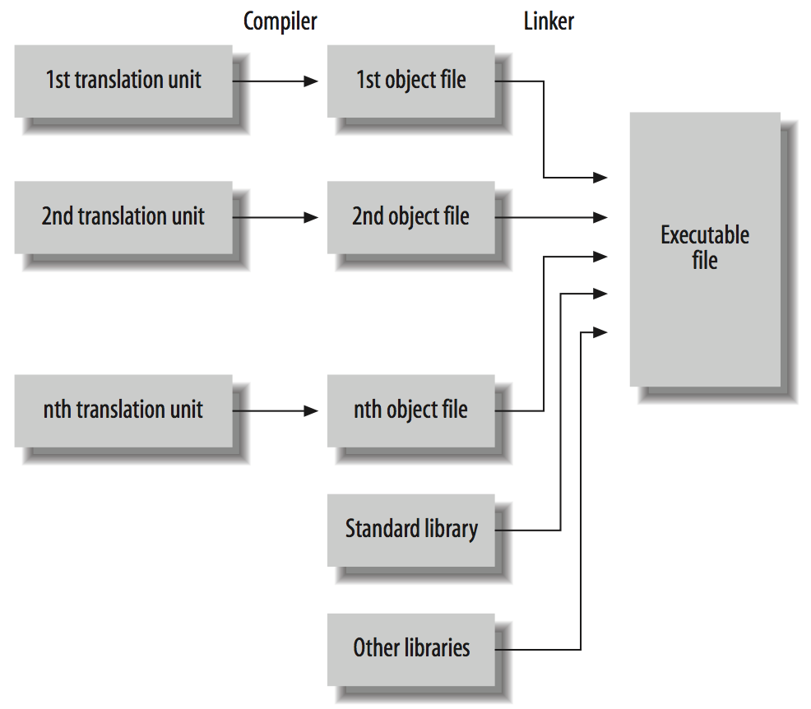
Hi, I’m the LINKER
mainfile.c + hello.h
hello.c + hello.h
Target program

Slide 11
example
hellolib.h
void myPrintHello(void);
#include “hellolib.h”
int main() {
// call a function in another file
myPrintHello();
return(0);
}
mainfile.c
#include <stdio.h>
#include “hellolib.h”
void myPrintHello(void) {
printf("Hello!\n");
return;
}
hellolib.c
mainfile.o
hellolib.o
Unit 1
Unit 2
gcc –o main mainfile.o hellolib.o
gcc –c mainfile.c
gcc –c hellolib.c

Slide 12
steps
mainfile.c
Preprocessor
mainfile.i
Compiler
fmainfile.o
hello.o
mainfile.s
Assembler
mainfile.o
Linker
main
executable

Slide 13
Compiling separately
Note that
gcc -o mainfile mainfile.c hellolib.c
Is different from compiling
gcc –c mainfile.c
gcc –c hellolib.c
In this second case you are compiling the two files separately: you do not need hellolib.c to do
gcc –c mainfile.c
And viceversa
You can start writing one before the other one

Slide 14
Compiler and LINKER
file1.c
file1.o
file_ex
file2.c
file2.o
gcc -c file1.c
gcc -o file_ex file1.o file2.o
gcc -c file2.c

Slide 15
modular programming
When a program consists of several source files, you need to declare the same functions and global variables, and define the same macros and constants, in many of the files.
The header (.h) contains only macro defintion, types definition, and function declarations that client program are allowed to see and to use.
All these things, which a programmer wants to “offer” to other files, need to be included in the .h
Every other private item internal to the module must stay inside the code file. We will now describe in detail the header and the code file.

Slide 16
example
void myPrintHello();
enum color {black, white};
const double p= 3.14;
hello.h
#include “hello.h”
int main() {
// call a function in another file
myPrintHello();
return(0);
}
mainfile.c
#include <stdio.h>
#include “hello.h”
void myPrintHello(void) {
printf("Hello %f!\n”, p);
return;
}
hello.c
gcc -o mainfile mainfile.c hello.c

Slide 17
IMPORTANT
In hellolib.c INCLUDE hello.h
Including its own header, the compiler grabs all the constants, types and variables it requires.
Another useful effect of including the header is that prototypes are checked against the actual functions, so that for example if you forgot some argument in the prototype, or if you changed the code missing to update the header, then the compiler will detect the mismatch with a proper error message.

Slide 18
library
double sum (double, double );
double min (double, double );
double mul (double, double );
double div (double, double );
const double p= 3.14;
arithLib.h
A library works exactly in this way
#include “arithLib.h”
double sum (double p1, double p2) {
return (p1+ p2);
}
// ….
arithLib.c
#include “arithLib.h”
int main() {
double a= 0.0, b= 0.0;
scanf(“%f”, &a);
scanf(“%f,” &b);
int result = sum(a, b);
// Other statements
}
mainfile.c

Slide 19
STORAGE SPECIFIERS

Slide 20
Storage class SPECIFIERS
A storage class specifier in a declaration modifies the linkage of the identifier declared, and the storage duration of the corresponding objects.
We have seen storage duration in previous slides.
Storage specifier: auto, register, static, extern.
A frequent source of confusion in regard to C is the fact that linkage, which is a property of identifiers, and storage duration, which is a property of objects, are both influenced in declarations by the same set of keywords—the storage class specifiers.
Remember: objects have storage duration, not linkage; and identifiers have linkage, not storage duration.

Slide 21
Storage class
No more than one storage class specifier may appear in a declaration.
No -> static extern int a;
Function identifiers may be accompanied only by the storage class specifier extern or static.
Function parameters may take only the storage class specifier register.
Variable identifiers may have auto, register, static, extern.

Slide 22
linkage
The linkage of an identifier defines if that identifier can be used in other translation units or not
A sort of scope among different files
A function identifier can have
Internal or external linkage
A variable identifier can have
Internal, external, or no linkage

Slide 23
static
Static: a function identifier declared with the specifier static has internal linkage.
Such an identifier cannot be used in another translation unit to access the function.
An object identifier declared with static has either no 1) linkage or 2) internal linkage, depending on whether the object’s definition is 1) inside a function or 2) outside all functions.
Objects declared with static always have static storage duration. Thus the specifier static allows you to define local objects—that is, objects with block scope—that have static storage duration.

Slide 24
extern
Extern: function and object identifiers declared with the extern specifier have external linkage:
You can use them anywhere in the entire program.
The compiler treats function declarations without a storage class specifier as if they included the specifier extern. They have external linkage.
Similarly, any variable identifier that you declare outside all functions and without a storage class specifier have external linkage. Without extern, the identifiers of global variables have external linkage as well.

Slide 25
No linkage
Variable identifiers that are local to functions, without extern specifier, that is no specifier or static, have no linkage
Also parameters of functions have no linkage: they are local to their function
static int c;
int fun (int a, int b) {
int res= a + b;
extern int c
static int d= res + c;
return res;
}
a, b, res,d have no linkage
c has the linkage of the name it refers to, in this case, internal linkage

Slide 26
Example (linkage)
int func1( void );
int a;
extern int b;
static int c;
static void func2( int d ) {
extern int a;
int b = 2;
static int e;
extern int c;
/* ... */
}
void fun3 (void) {
/* commands */
}
func1 external
a external
b external
c internal
func2 internal, d no linkage
external, this a is the same as above
no linkage
no linkage
c is the same as the c above: internal
external

Slide 27
DECLARATION AND DEFINITION OF VARIABLES

Slide 28
DECLARATION OF functions
A function declaration is a definition if it contains the function block.
int iMax( int a, int b ) // This is the function's definition. a and
// b are defined
{
return ( a >= b ? a : b );
}

Slide 29
DECLARATION OF VARIABLES
An object declaration is a definition if it allocates storage for the object.
With extern specifier, a variable is declared
Declarations that include initializers are always definitions.
Furthermore, all declarations within function blocks are definitions unless they contain the storage class specifier extern.
extern int a = 10;
extern double b;
void func(int a) {
extern char c;
static short d;
float e;
}
// Definition of a.
// Declaration of b, which needs to be
// defined elsewhere in the program.
// Definition of a
// Declaration of c, not a definition.
// Definition of d.
// Definition of e.

Slide 30
BACK TO LINKAGE WITH EXAMPLES

Slide 31
Example 1
write.c
#include<stdio.h>
extern int count;
void write_extern(void)
{
printf("count is %i\n", count);
}
main.c
static int count=5;
void write_extern();
int main() {
write_extern();
}
count (defined) has internal linkage in main.c: visible only in main.c
count (declared) has external linkage in write.c
write_extern (declared) has external linkage in main.c: is a declaration of function. Its definition is elsewhere
write_extern (defined) has external linkage in main.c: it is a definition of function: it is visible in other translation units

Slide 32
Example 1
write.c
#include<stdio.h>
extern int count;
void write_extern(void)
{
printf("count is %i\n", count);
}
main.c
static int count=5;
void write_extern();
int main() {
write_extern();
}
gcc -o main write.c main.c
Undefined symbols for architecture x86_64:
"_count", referenced from:
_write_extern in write-e81d6a.o
ld: symbol(s) not found for architecture x86_64
clang: error: linker command failed with exit code 1 (use -v to see invocation)

Slide 33
Example 2
write.c
#include<stdio.h>
extern int count;
static void write_extern(void)
{
printf("count is %i\n", count);
}
main.c
int count= 5;
void write_extern();
int main() {
write_extern();
}
count (defined) has external linkage in main.c: visible also in other translation units
count (declared) has external linkage in write.c
write_extern (declared) has external linkage in main.c: is a declaration of function. Its definition is elsewhere
write_extern (defined) has internal linkage in write.c: it is not visible elsewhere

Slide 34
Example 2
write.c
#include<stdio.h>
extern int count;
static void write_extern(void)
{
printf("count is %i\n", count);
}
main.c
int count= 5;
void write_extern();
int main() {
write_extern();
}
gcc -o main write.c main.c
MacBook-Francesco:ProgrammI francescosantini$ gcc -o main main.c write.c
Undefined symbols for architecture x86_64:
"_write_extern", referenced from:
_main in main-a3af3a.o
ld: symbol(s) not found for architecture x86_64
clang: error: linker command failed with exit code 1 (use -v to see invocation)

Slide 35
Example 3
write.c
#include<stdio.h>
extern int count;
extern void write_extern(void)
{
printf("count is %i\n", count);
}
main.c
int count=5;
void write_extern();
int main() {
write_extern();
}
gcc –c main.c
gcc –c write.c
gcc –o main main.o write.o
With or without it is the same
OK!

Slide 36
Example 4
write.c
#include<stdio.h>
extern int count;
void write_extern(void)
{
printf("count is %i\n", count);
}
main.c
int count=5;
void write_extern();
int main() {
write_extern();
}
gcc –o main main.c
Undefined symbols for architecture x86_64:
"_write_extern", referenced from:
_main in main-95ef15.o
ld: symbol(s) not found for architecture x86_64
clang: error: linker command failed with exit code 1 (use -v to see invocation)

Slide 37
Example 5
write.c
#include<stdio.h>
extern int count;
void write_extern(void)
{
printf("count is %i\n", count);
}
main.c
int count=5;
void write_extern();
int main() {
write_extern();
}
gcc –o write write.c
Undefined symbols for architecture x86_64:
"_count", referenced from:
_write_extern in write-713128.o
"_main", referenced from:
implicit entry/start for main executable
ld: symbol(s) not found for architecture x86_64
clang: error: linker command failed with exit code 1 (use -v to see invocation)

Slide 38
Tentative definition
If you declare an object outside of all functions, without an initializer and without the storage class specifier extern, the declaration is a tentative definition.
A tentative definition of an identifier remains a simple declaration if the translation unit contains another definition for the same identifier.
If not, then the compiler behaves as if the tentative definition had included an initializer with the value zero, making it a definition.

Slide 39
Example of tentative definition
#include<stdio.h>
int count= 3;
int count= 4;
int main (void) {
printf("count is %i\n", count);
}
#include<stdio.h>
int count;
int count= 4;
int main (void) {
printf("count is %i\n", count);
}
main.c
main.c
gcc main.c
MacBook-Francesco:ProgrammI francescosantini$ gcc write.c
write.c:5:5: error: redefinition of 'count'
int count= 4;
^
write.c:4:5: note: previous definition is here
int count= 3;
^
1 error generated.
gcc main.c
OK!: count is 4

Slide 40
example
write.c
#include<stdio.h>
extern int count;
void write_extern(void)
{
printf("count is %i\n", count);
}
main.c
int count=5;
void write_extern();
int main() {
write_extern();
}
gcc -o main write.c main.c
OK!

Slide 41
TO SUM UP

Slide 42
linkage
An identifier with external linkage represents the same function or object throughout the program. The compiler presents such identifiers to the linker, which resolves them with other occurrences in other translation units and libraries.
An identifier with internal linkage represents the same object or function within a given translation unit. The identifier is not presented to the linker. As a result, you cannot use the identifier in another translation unit to refer to the same object or function.
No linkage
Function parameters
Object identifiers that are declared within a function and without the storage class specifier extern

Slide 43
Example (definition or declaration)
int func1( void );
int a= 3;
int b;
extern int b = 1;
static int c;
static void func2( int d ) {
extern int a;
int b = 2;
static int e;
/* ... */
}
declaration
definition
attempt of definition / declaration
definition
definition
func2 definition, d definition
declaration
definition
definition
Since b is external by default, if it is defined in a different translation unit, then this is a declaration, otherwise it is a definition.

Slide 44
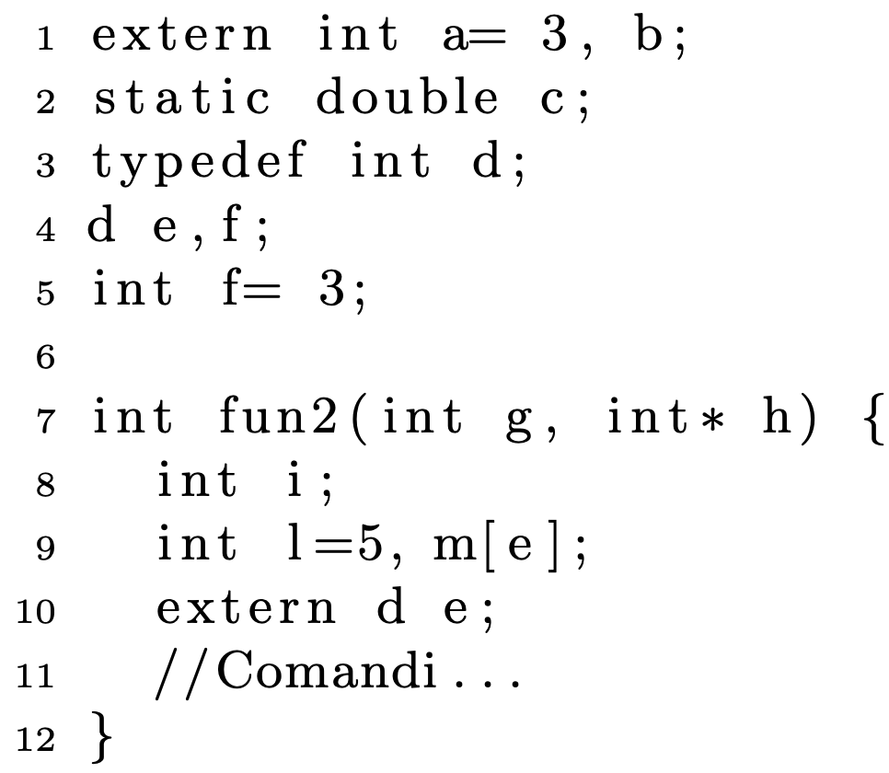
Declaration or definition?
1 a definito
1 b dichiarato
2 c definito
4 e tentativo di definizione -> definizione
4 f tentativo di definizione -> dichiarazione
7 fun2 definita
7 g e h definite
8 i definita
9 l e m definite
10 e dichiarato (definito alla linea 4)

Slide 45
linkage
1 a external
1 b external
2 c internal
4 e external
4 f external
7 fun2 external
7 g e h no linkage
8 i no linkage
9 l e m no linkage
10 e ha il linkage di e a linea 4

Slide 46
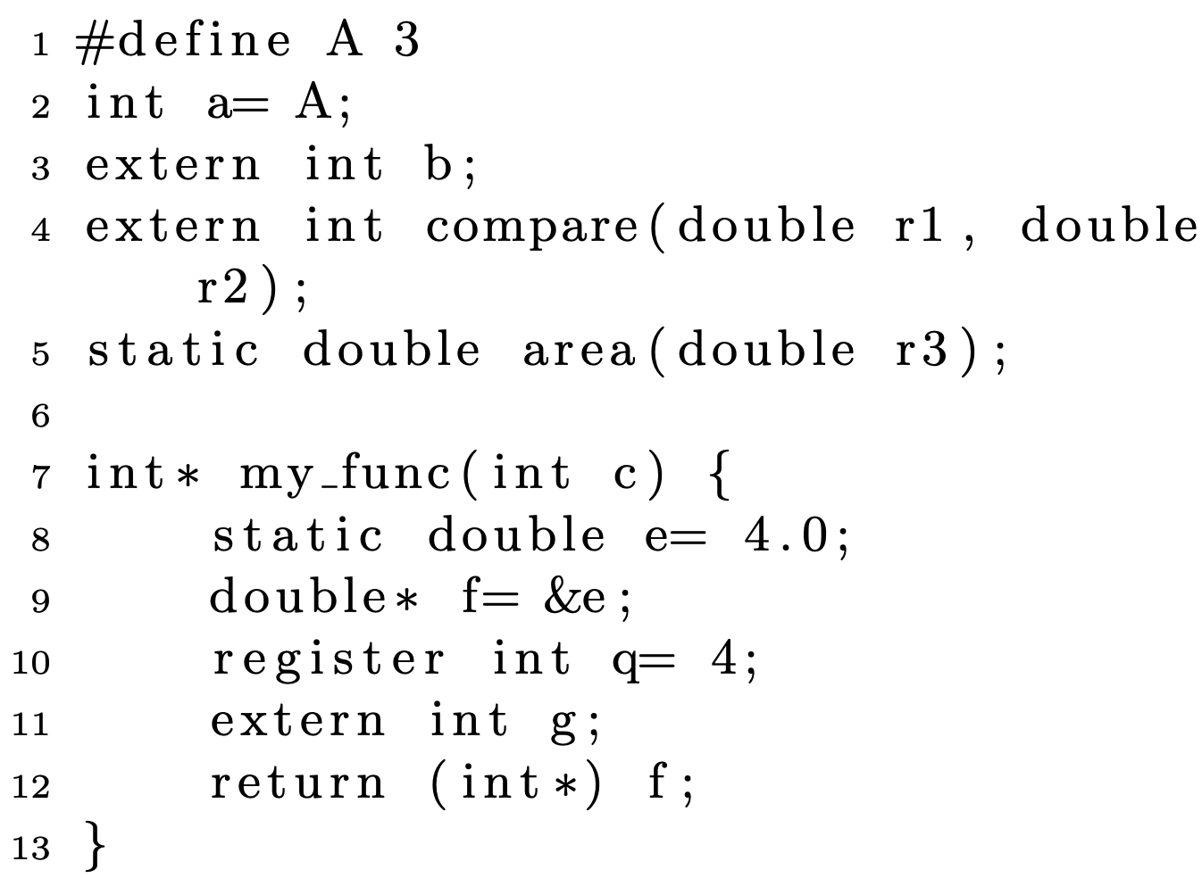
2 a definita (linkage esterno)
3 b dichiarata (linkage esterno)
4 compare dichiarata (linkage esterno)
5 area dichiarata (linkage interno)
I parametri nelle dichiarazioni sono dichiarati
7 my_func definita (linkage esterno)
7 c definita (no linkage)
8 e definita (no linkage)
E le altre?

Slide 47
Su libro e riferimenti
Sezione 1.9.2
Sezione 5.2
Sezione 15.4
Dichiarazione e definizione
https://www.cprogramming.com/declare_vs_define.html
https://stackoverflow.com/questions/1410563/what-is-the-difference-between-a-definition-and-a-declaration
Su linkage
https://www.geeksforgeeks.org/internal-linkage-external-linkage-c/
https://aticleworld.com/linkage-in-c/

